Slide 1
AVD Campus Fabric Testing
Brian Hayes

Slide 2
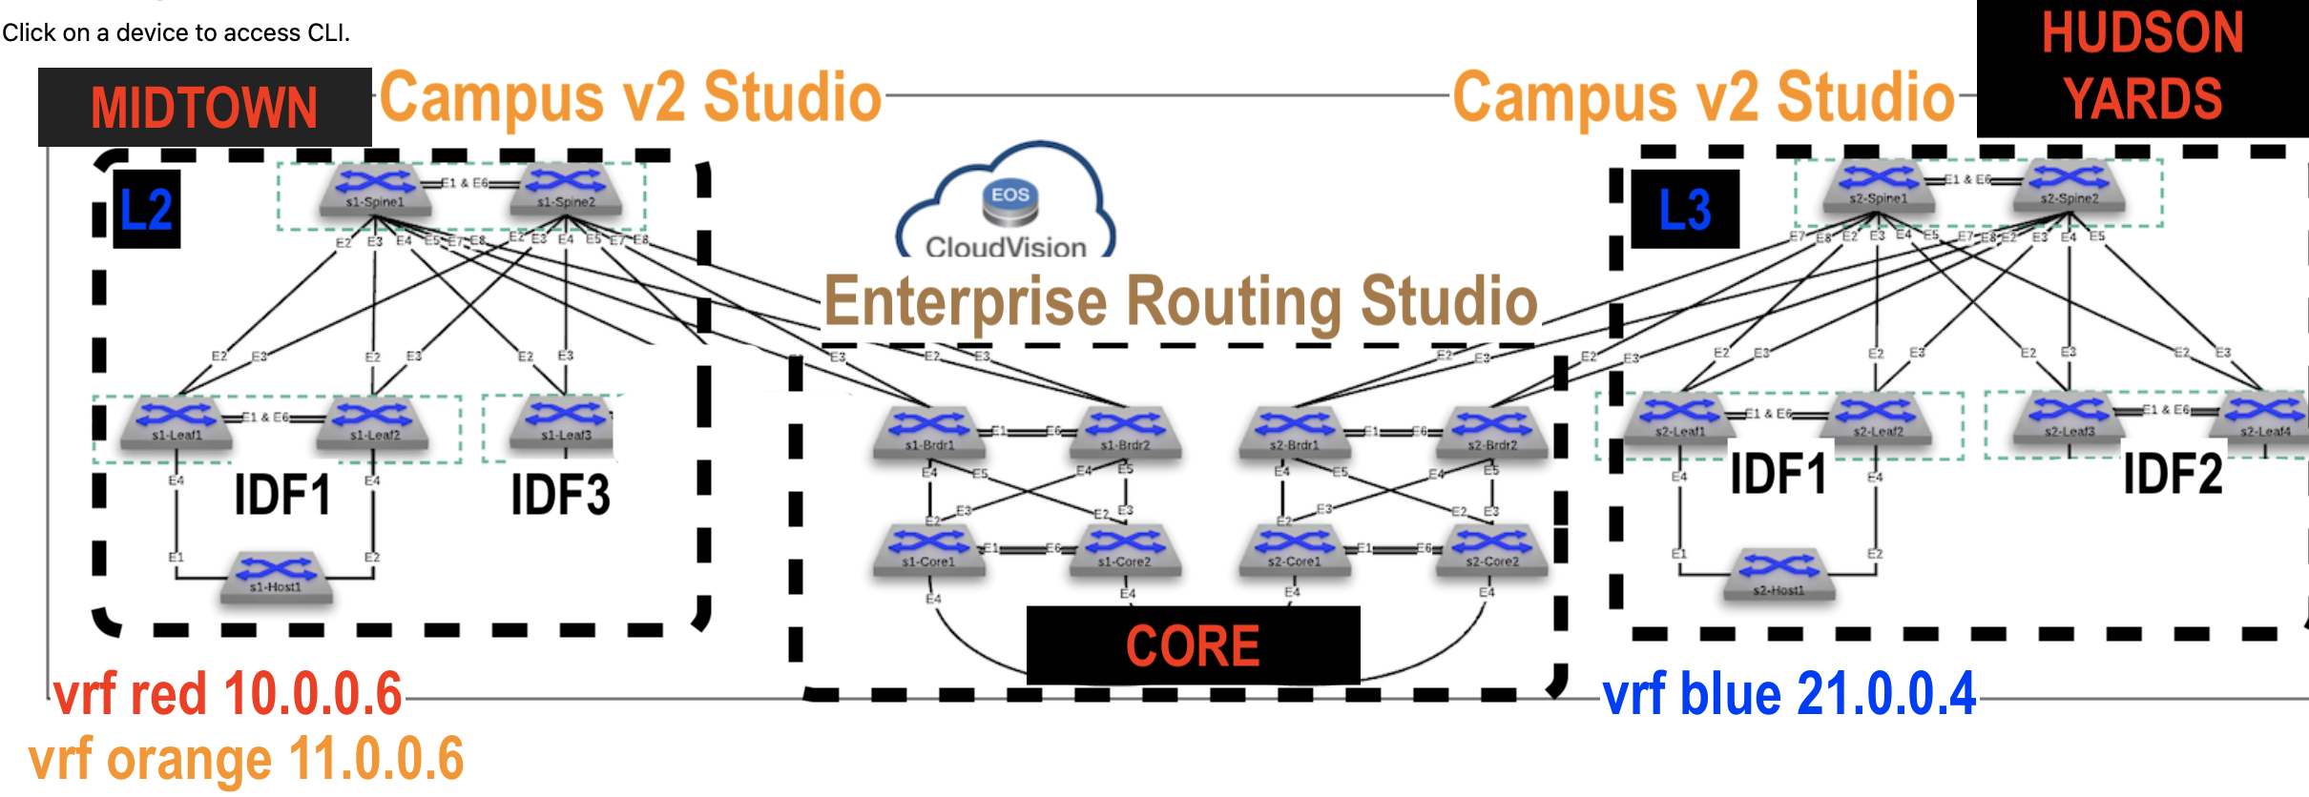
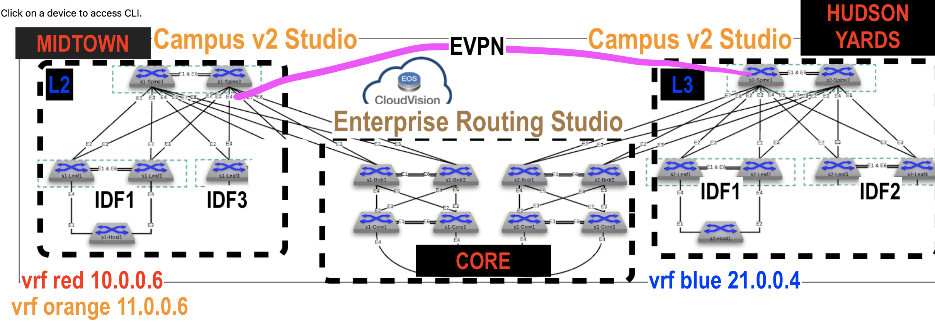
ATD Test Setups
1. BGP
2. BGP w EVPN
3. OSPF
4. OSPF w EVPN

Slide 3
BGP

Slide 4
BGP EVPN

Slide 5
OSPF

Slide 6
OSPF EVPN

